Slide 1
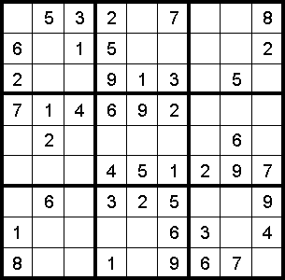
Hypothesis tests for more than two means

Slide 2
Overview
Taking stock of where we are and where we are going
Hypothesis tests for more than two means
Hypothesis tests for correlation

Slide 3



Slide 4
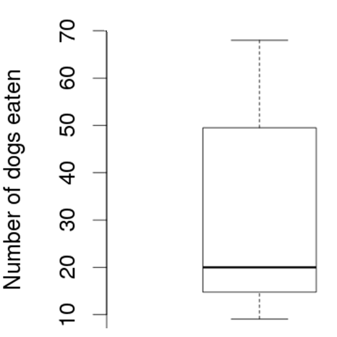
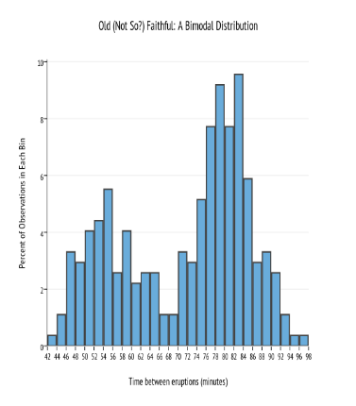
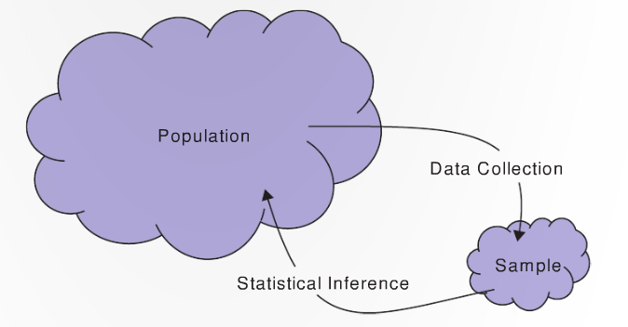
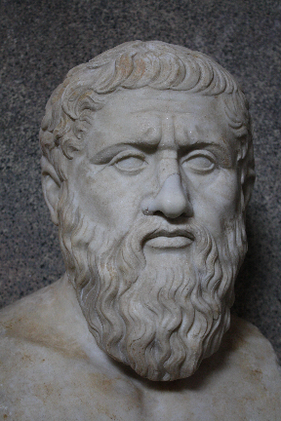

Where we are: what we have covered
Descriptive statistics
Statistical inference
We have used computational methods for inference
π, μ, σ, ρ
p̂, x̅, s, r

Slide 5
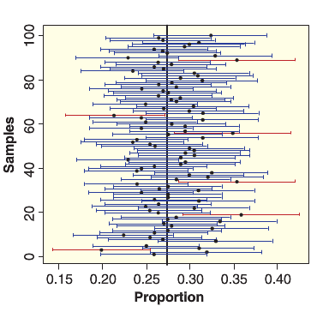


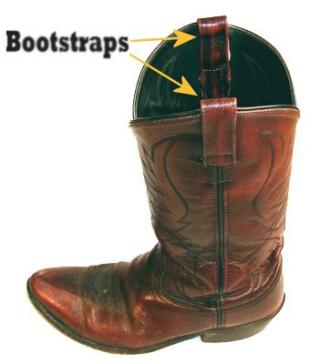
Where we are: what we have covered
Statistical inference using computational methods
Confidence intervals using the bootstrap
Hypothesis tests using permutation/randomization tests
Single proportion and two means

Slide 6
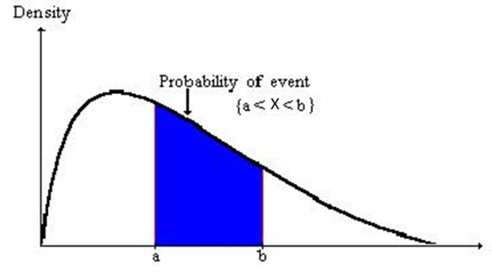
Where we are: where are we going…
Continuation of statistical inference using computational methods
Hypothesis tests for more than two means and correlation
Theories of hypothesis tests
Statistical inference based on math/theory
t-tests, ANOVA, regression, etc.

Slide 8
Hypothesis tests for more than two means

Slide 9

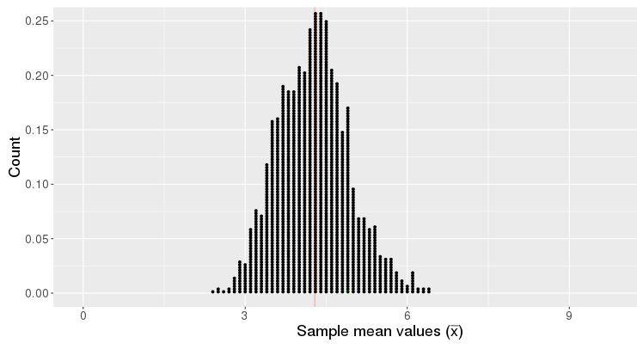
The logic of hypothesis tests…
We start with a claim about a population parameter
E.g., µ = 4.2
This claim implies we should get a certain distribution of statistics
If our observed statistic is highly
unlikely, we reject the claim

Slide 10

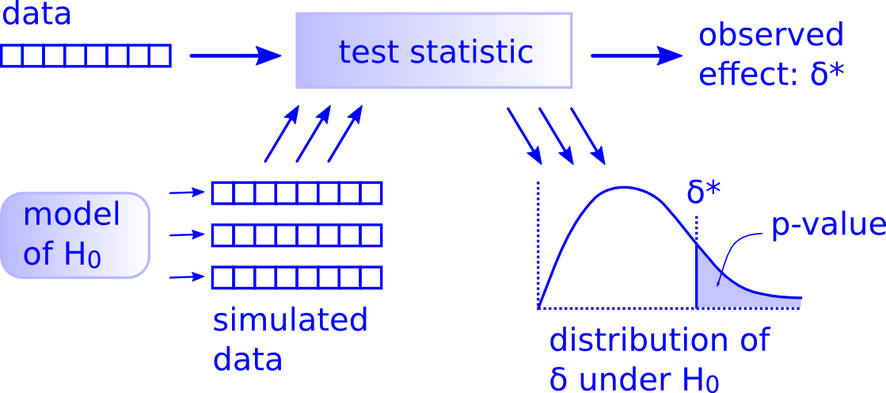
The logic of hypothesis tests…
There is only one hypothesis test!
Just follow the 5 hypothesis tests steps!

Slide 11
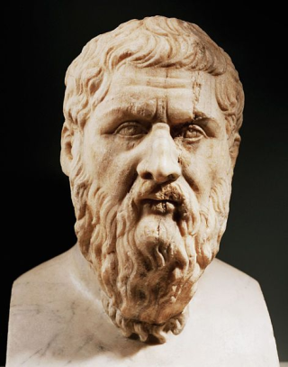
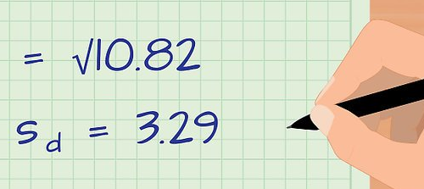
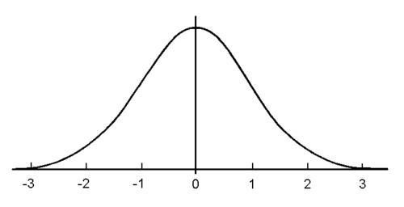

Five steps of hypothesis testing
1. State H₀ and H_{A}
Assume Gorgias (H₀) was right
2. Calculate the actual observed statistic
3. Create a null distribution of statistics that are consistent with H₀
i.e., a distribution of statistics that we would expect if Gorgias is right
4. Get the probability we would get a statistic more
than the observed statistic from the null distribution
p-value
5. Make a judgement
Assess whether the results are statistically significant
Notes:
How do we gather evidence? Calculate observed stat
How do we create the null distribution

Slide 12
Comparing more than two means
A group of Hope College students wanted to see if there was an association between a student’s major and the time it takes to complete a small Sudoku-like puzzle

Slide 13
Comparing more than two means
A group of Hope College students wanted to see if there was an association between a student’s major and the time it takes to complete a small Sudoku-like puzzle
They grouped majors into four categories
Applied science (as)
Natural science (ns)
Social science (ss)
Arts/humanities (ah)
What is the first step of hypothesis testing?

Slide 14
Sudoku by field
1. State the null and alternative hypotheses!
H₀: μ_{as} = μ_{ns} = μ_{ss} = μ_{ah}
H_{A}: μ_{i} ≠ μ_{j} for one pair of fields of study
What should we do next?
Let’s plot the data first…

Slide 15
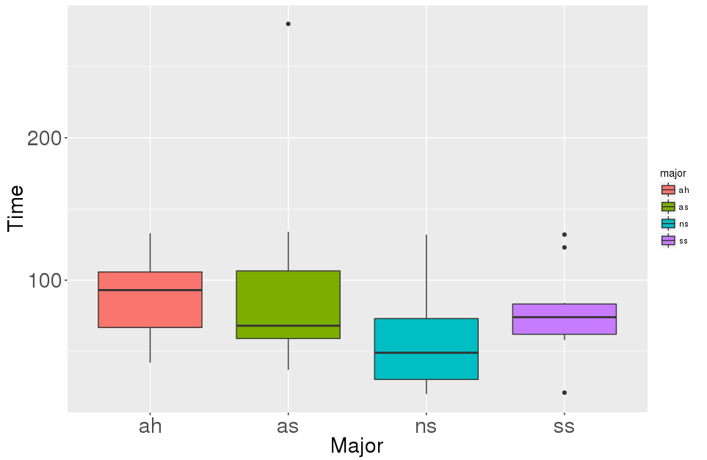
Step 2a: Plot of completion time by major
What should we do next?

Slide 16
Sudoku by field
1. State the null and alternative hypotheses!
H₀: μ_{as} = μ_{ns} = μ_{ss} = μ_{ah}
H_{A}: μ_{i} ≠ μ_{j} for one pair of fields of study
Thoughts on the statistic of interest?

Slide 17
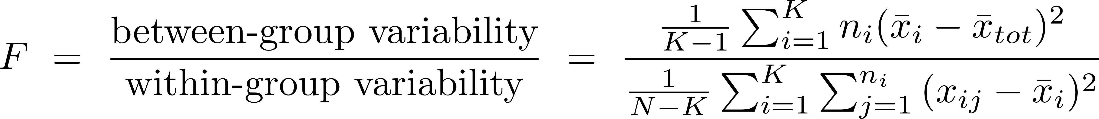
Comparing multiple means
There are many possible statistics we could use. A few choices are:
1. Group range statistic:
max x̅ - min x̅
2. Mean absolute difference (MAD):
(|x̅_{as} - x̅_{ns}| + |x̅_{as} - x̅_{ss}|+ |x̅_{as} - x̅_{ah}| +|x̅_{ns} - x̅_{ss}| + |x̅_{ns} - x̅_{ah}|+ |x̅_{ss} - x̅_{ah}|)/6
3. F statistic:

Slide 18
Using the MAD statistic
Mean absolute difference (MAD):
(|x̅_{as} - x̅_{ns}| + |x̅_{as} - x̅_{ss}|+ |x̅_{as} - x̅_{ah}| +|x̅_{ns} - x̅_{ss}| + |x̅_{ns} - x̅_{ah}|+ |x̅_{ss} - x̅_{ah}|)/6
Observed statistic value = 20.88
How can we create the null distribution?

Slide 19
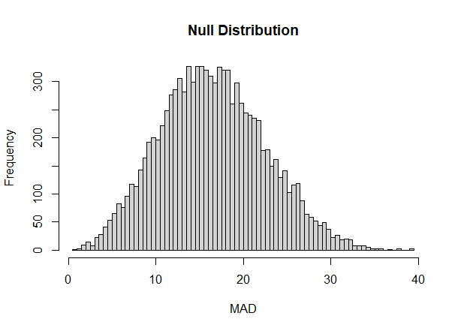
Null distribution

Slide 20
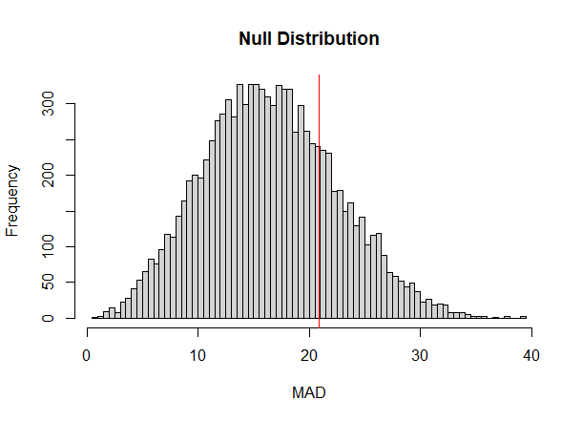
P-value
p-value = .233

Slide 21
Conclusions?

Slide 22
Hypothesis tests for more than two means in R
Step 1: null and alternative hypotheses…
H₀: μ_{as} = μ_{ns} = μ_{ss} = μ_{ah}
H_{A}: μ_{i} ≠ μ_{j} for one pair of fields of study

Slide 23
Let’s try this analysis in R…
# get the data
library(SDS100)
download_data("MajorPuzzle.txt")
sudoku_data <- read.table("MajorPuzzle.txt", header = TRUE)
# Extract vectors from the data frame (how do we do this?)
completion_time <- sudoku_data$time
major <- sudoku_data$major

Slide 24
Visualize the data
How can we visualize the data?
# We can create side-by-side boxplots using
boxplot(completion_time ~ major,
xlab = "Major", ylab = "Time (s)")

Slide 25
Calculating the statistic of interest
We can get the MAD statistic using the get_MAD_stat() function
get_MAD_stat(data_vector, grouping_vector)
data_vector: a vector of quantitative data
grouping_vector: a vector indicating which group the quantitative data is in
Can you get the MAD statistic for the sudoku data?
obs_stat <- get_MAD_stat(completion_time, major)
Notes:
boxplot(completion_time ~ shuffled_majors, ylab = "Time (s)")

Slide 26
Creating the null distribution
Q: How could we create one point in a null distribution?
A: Shuffle the grouping_vector (major vector) and calculate the MAD statistic
Q: How can we do this in R?
shuffled_majors <- shuffle(major)
get_MAD_stat(completion_time, shuffled_majors)
Notes:
(data, grouping)

Slide 27
Creating the null distribution
Q: How can we create a full null distribution?
null_dist <- do_it(10000) * {
shuffled_majors <- shuffle(major)
get_MAD_stat(completion_time, shuffled_majors)
}
# visualize the null distribution
hist(null_dist, breaks = 100)
abline(v = obs_stat, col = "red")
Notes:
(data, grouping)

Slide 28

Creating the null distribution
Q: What do we do next and how do we do it?
A: We get the p-value
pnull(obs_stat, null_dist, lower.tail = FALSE)
Notes:
(data, grouping)

Slide 29

Hypothesis tests for correlation

Slide 30
The logic of hypothesis tests
There is only one hypothesis test!
Just follow the 5 hypothesis tests steps!

Slide 31
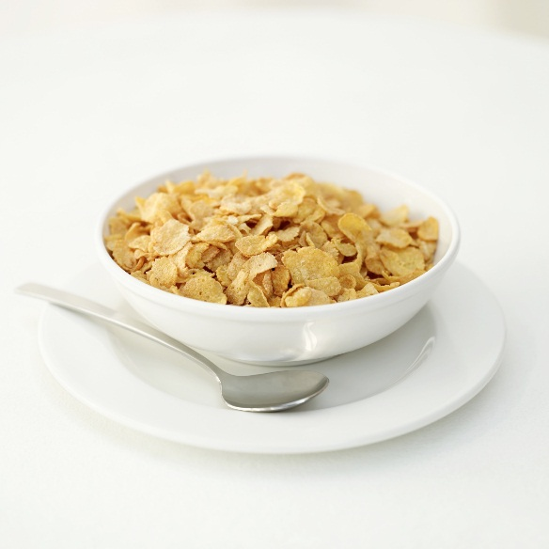
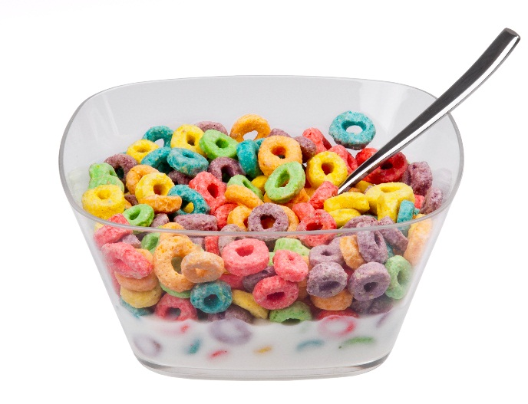
Hypothesis tests for correlation
Is there a positive correlation between the number of carbohydrates in a cereal and the number calories?
What is the population parameter and the statistic of interest?

Slide 32
Significance tests for correlation
Let's look at data from 30 randomly selected cereals
What is the first step we should do for running a hypothesis test?
 | Calories | Carbohydrates
AppleJacks | 117 | 27
Boo Berry | 118 | 27
Cap’n Crunch | 144 | 31
Cinnamon Toast Crunch | 169 | 32

Slide 33
Hypothesis testing for correlation
1. Write down the null and alternative in symbols and words
2. Load the data and compute the observed statistic:
> download_data("cereal.Rda")
> load("cereal.Rda")
3. Let’s extract the calories and carbohydrates from the data frame
> calories <- cereal$Calories
> carbs <- cereal$Carbs

Slide 34
Try this at home!
Step 2: What is the observed statistic?
Also say whether you think you will be able to reject the null hypothesis based on a plot of your data
Step 3: Create the null distribution
To start with: how we can create one point in the null distribution?
Hint: think about shuffling the data
If you are able to create a null distribution, upload a plot of it to Canvas
Step 4: What is the p-value that you get?
Step 5: What decision would you make?

Slide 35

We will pick up from here next class…

